Slide 1
Property - vendor Management system
Group 9-
Rashmi Daga
Param Madan
Medhavi Pande

Slide 2
Problem SATEMENT AND GOAL
Problem Statement:
A property management company wants to develop a database for managing its business, particularly on the Accounts Payable side i.e. Vendor Management. They want to be able to records the purchase orders being sent and the invoices being received to vendors since a lot of data is being generated lately.
Goal:
The goal is to design and create an efficient database which will record all the necessary details related to vendor, the tenant for which the service is being provided, the purchase orders being sent, the invoices being received, details of the property, etc.

Slide 3
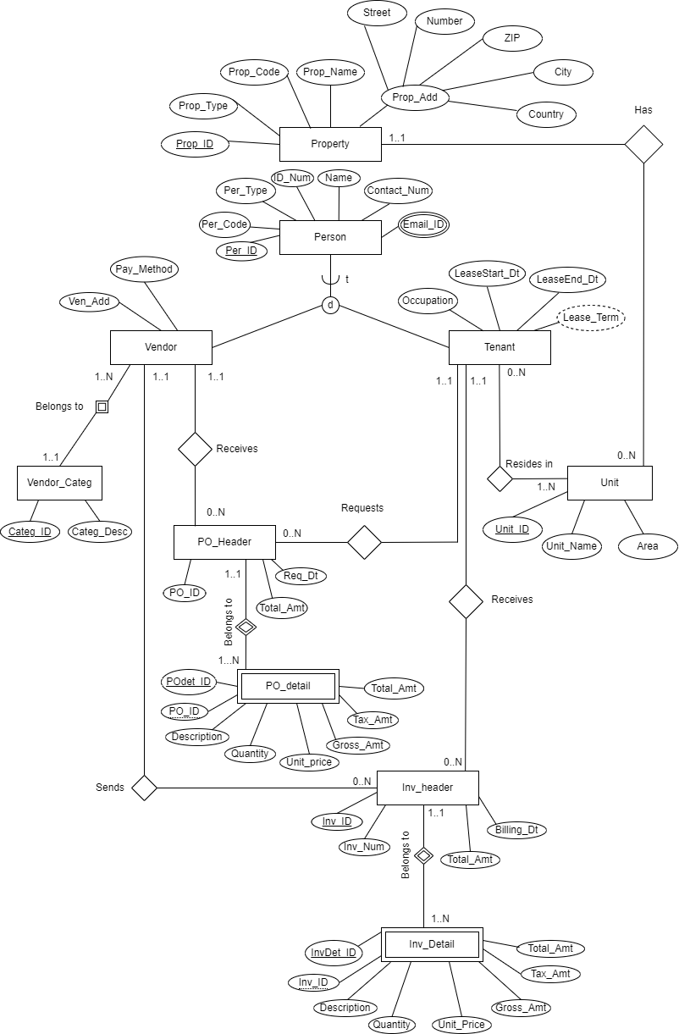
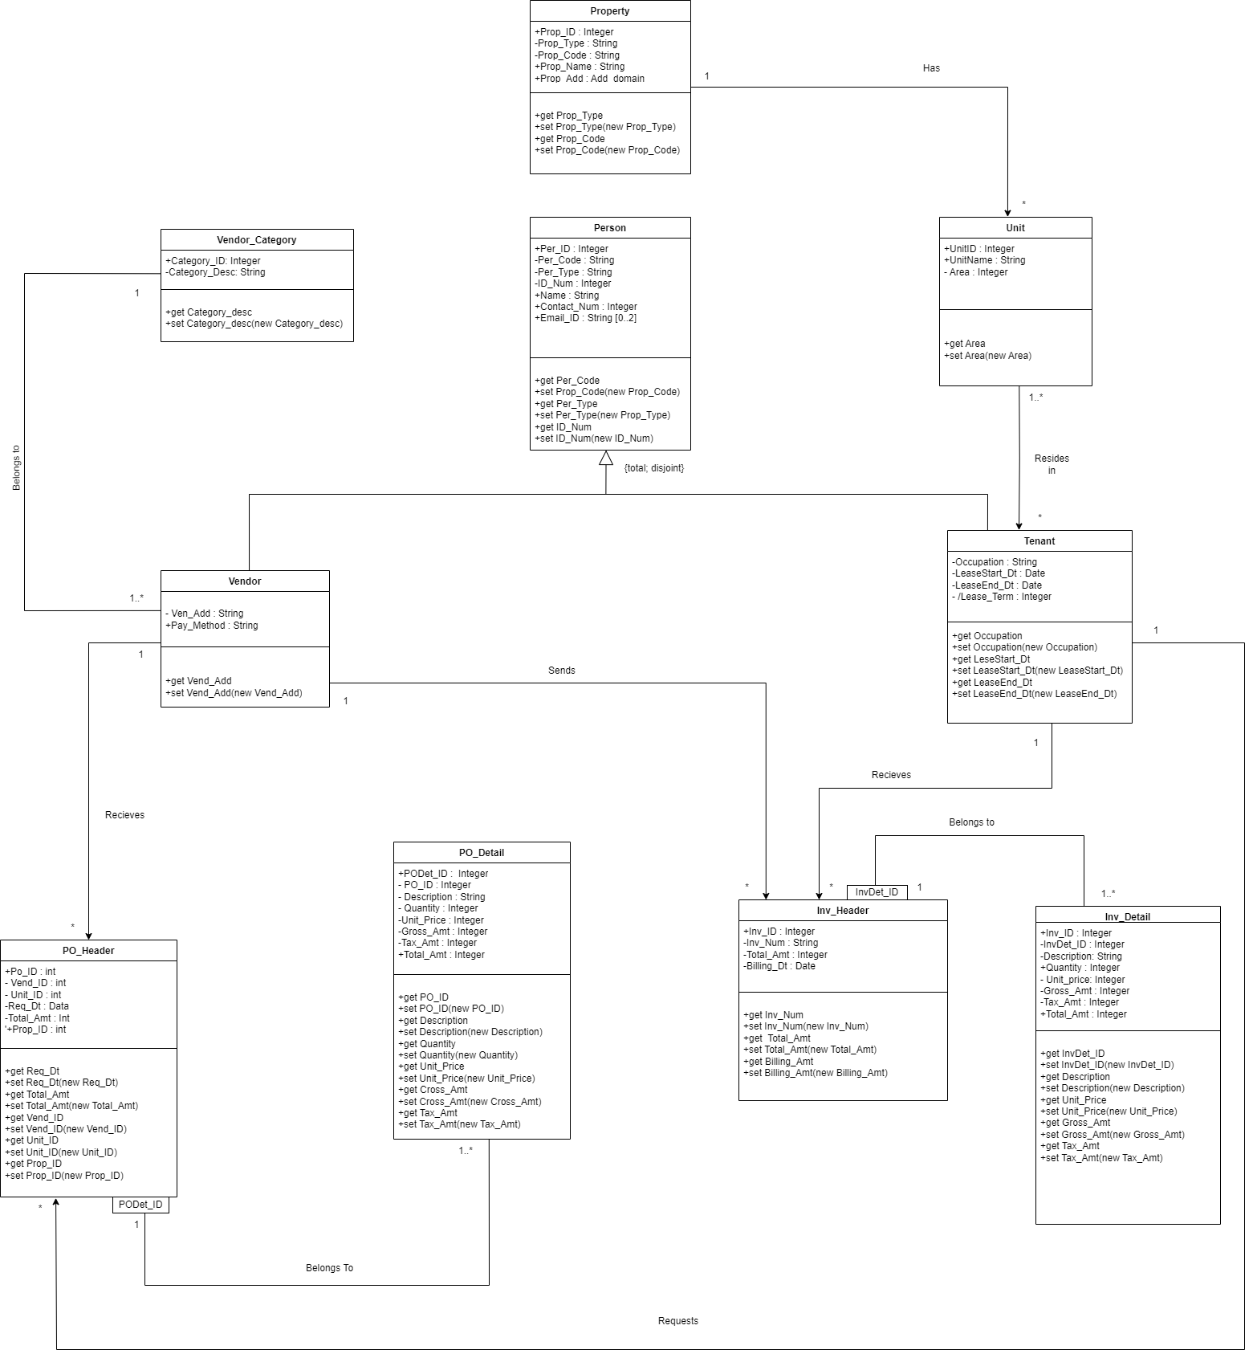
ENHANCED ENTITY RELATIONSHIP DIAGRAM

Slide 4
SCOPE OF ANALYTICS
1. Expense Management Analytics
Utilize analytics to effectively manage property expenses.
Identify vendors charging above average prices for negotiation and potential replacement with cost-effective alternatives.
2. Renovation Recommendations
Analyze analytics to pinpoint repetitive service requests, e.g., flooring or ceiling renovations.
Suggest property owners consider renovations based on the recurring demand for specific services.
3. Payment Method Analysis
Conduct analysis to determine the percentage of transactions for each payment method.
Use insights to minimize higher service charge methods.
Explore the possibility of developing an in-house payment gateway for vendors, tenants, and third-party transactions.
4. Future Business Opportunities
Consider extending the property management business to create a vendor marketplace.
Highlight the benefits of a centralized platform for interacting with vendors.
Explore the potential of acting as a third-party provider for other companies and tenants.

Slide 5
LIVE DEMO!

